Slide 1
CS 670 IC
RESEARCH PROJECT
SECURED VIRTUAL NETWORK – REPOSITORY FOR HUMAN RESOURCE MANAGEMENT SYSTEM
NCORP
ADVISOR: GREG KYRYTSCHENKO
NORI ROSHAN SHARMA
MS CYBER SECURITY

Slide 2
CONTENTS
INTRODUCTION
PROBLEM STATEMENT
DESIGN PLAN
PICTORIAL APPROACH
ISSUES TO BE ADDRESSED
SOLUTION
BUSINESS RULES
WEB APPLICATION FUNCTIONAL DECOMPOSITION, USECASE DIAGRAMS
ERD
WEBSITE
OWASP ESAPI TESTING
FUTURE ENHANCEMENTS
CONCLUSION

Slide 3
INTRODUCTION
NCORP
A SECURED VIRTUAL NETWORK – HUMAN RESOURCE MANAGEMENT SYSTEM
AIMED TO MAINTAIN THE COMPANY, SCHOOL, EMPLOYEE AND STUDENT PERSONAL PROFILES TO MAINTAIN THE INTEGRITY OF HUMAN RESOURCES

Slide 4
PROBLEM STATEMENT
DATA & IT ASSETS ARE AT RISK ( GOAL OF SECURITY IS TO ENSURE CIA )
PAPER WORK AT THE SCHOOLS & SMBs LEADS TO:
RISK OF LOSING (CIA) SECURITY PARAMETERS
More Paper usage
Less Physical Security
Time Delay
More physical work
Time, Money and Resources

Slide 5
PLAN
INFRASTRUCTURE, HOSTING, DEVELOPMENT, TESTING, SECURITY
NCORP

Slide 6
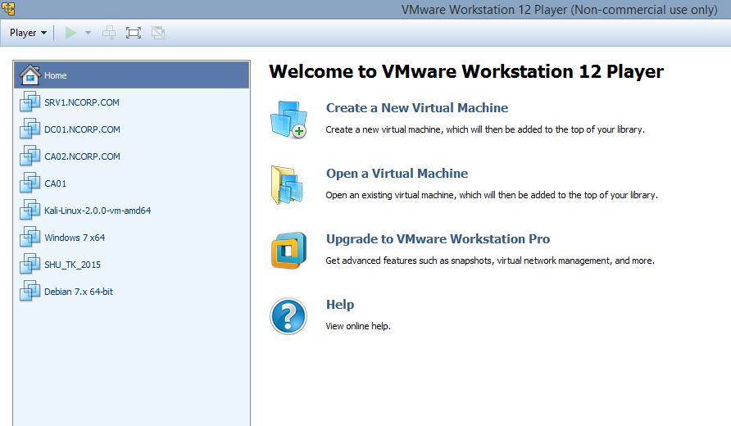

Slide 7
PICTORIAL APPROACH TO SECURITY
INFRA
DATA
NETWORK
PPT
VULNERABILITY MANAGEMENT THROUGH CONTINOUS MONITORING
PPT –PEOPLE PROCESS TECHNOLOGY

Slide 8
DC01 – DOMAIN CONTROLLER , DNS SERVER
SRV1 – WEB SERVER, Web Application Design
CA01 – CERTIFICATE AUTHORITY
KALI – FOR VULNERABILITY ASSESSMENTS

Slide 9
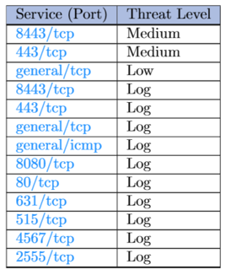
VULNERABILITIES: SRV1

Slide 10
SECURITY ISSUES
RECONNAISSANCE, System Enumeration, web server enumeration, web application enumeration, Active discovery, DOS, Brute Force Attack,, OPENVAS SCANNING REPORTS

Slide 11
SECURITY ISSUES
Reconnaissance, Active discovery, PING OF DEATH, fingerprinting ( WITH NETCAT SESSION )

Slide 12
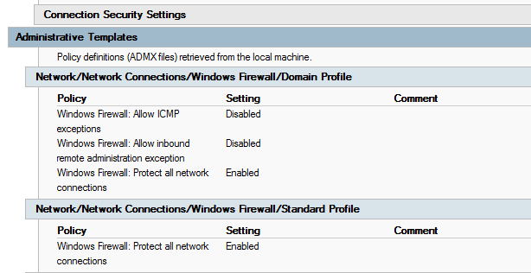
SECURITY MEASURES:
1) RECONNAISSANCE, ACTIVE DISOVERY, PING OF DEATH

Slide 13
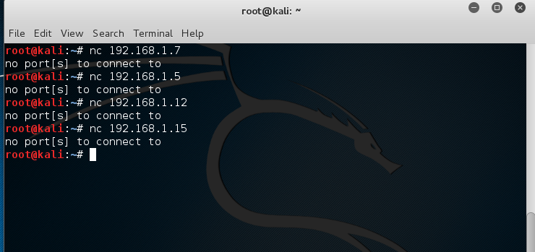
FINGER PRINTING WEB SERVERS FROM KALI

Slide 14
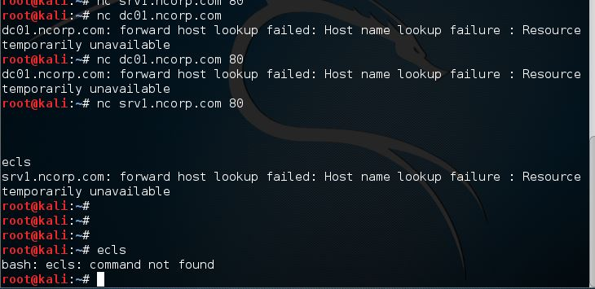

Slide 15
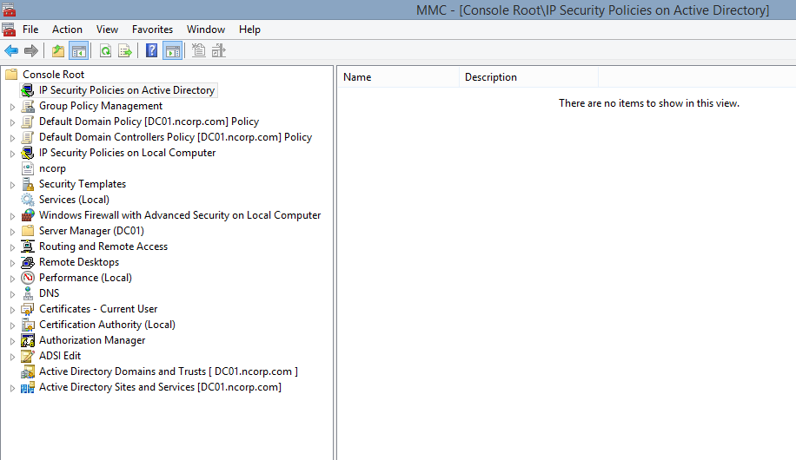
SOLUTION :
MY ADMINISTRATIVE CONSOLE FOR CONTINOUS MONITORING

Slide 16
VM
DC01 for MANAGEMENT CONSOLE: Continuous monitoring

Slide 17
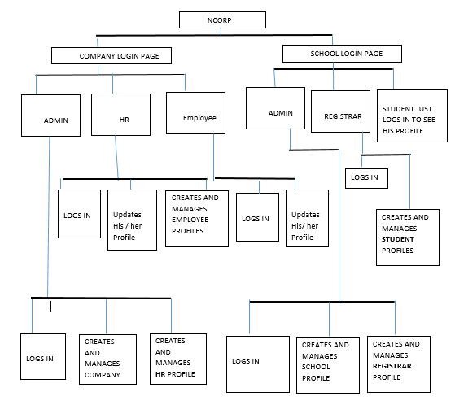
FUNCTIONAL DECOMPOSITION DIAGRAM

Slide 18
WEBSITE
VM : SRV1

Slide 19
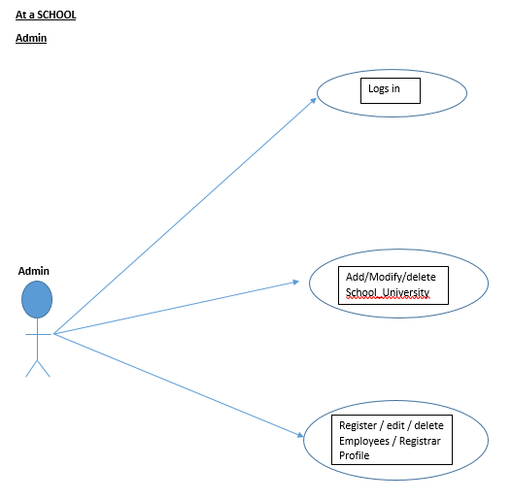
USECASE

Slide 20
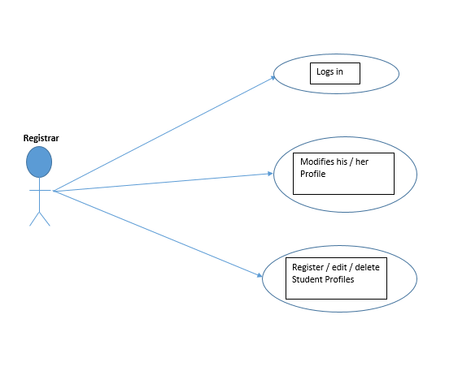
USECASE

Slide 21
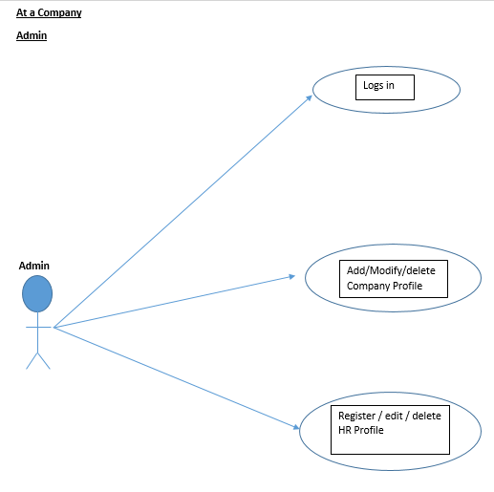
USECASE

Slide 22
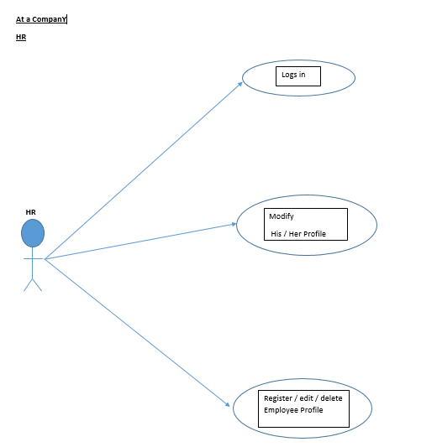
USECASE

Slide 23
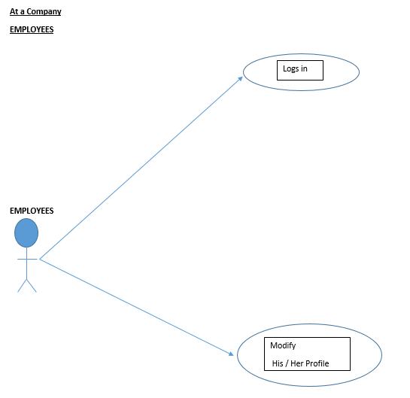
USECASE

Slide 24
ERD

Slide 25
OWASP – ESAPI TESTING
Information Gathering & Conducting Search engine discovery and Reconnaissance for information leakage
Ping of death
Fingerprint web server
Enumerate application on Webserver
Fingerprint web application
Testing Identity Management
Authentication Testing
Authorization Testing:

Slide 26
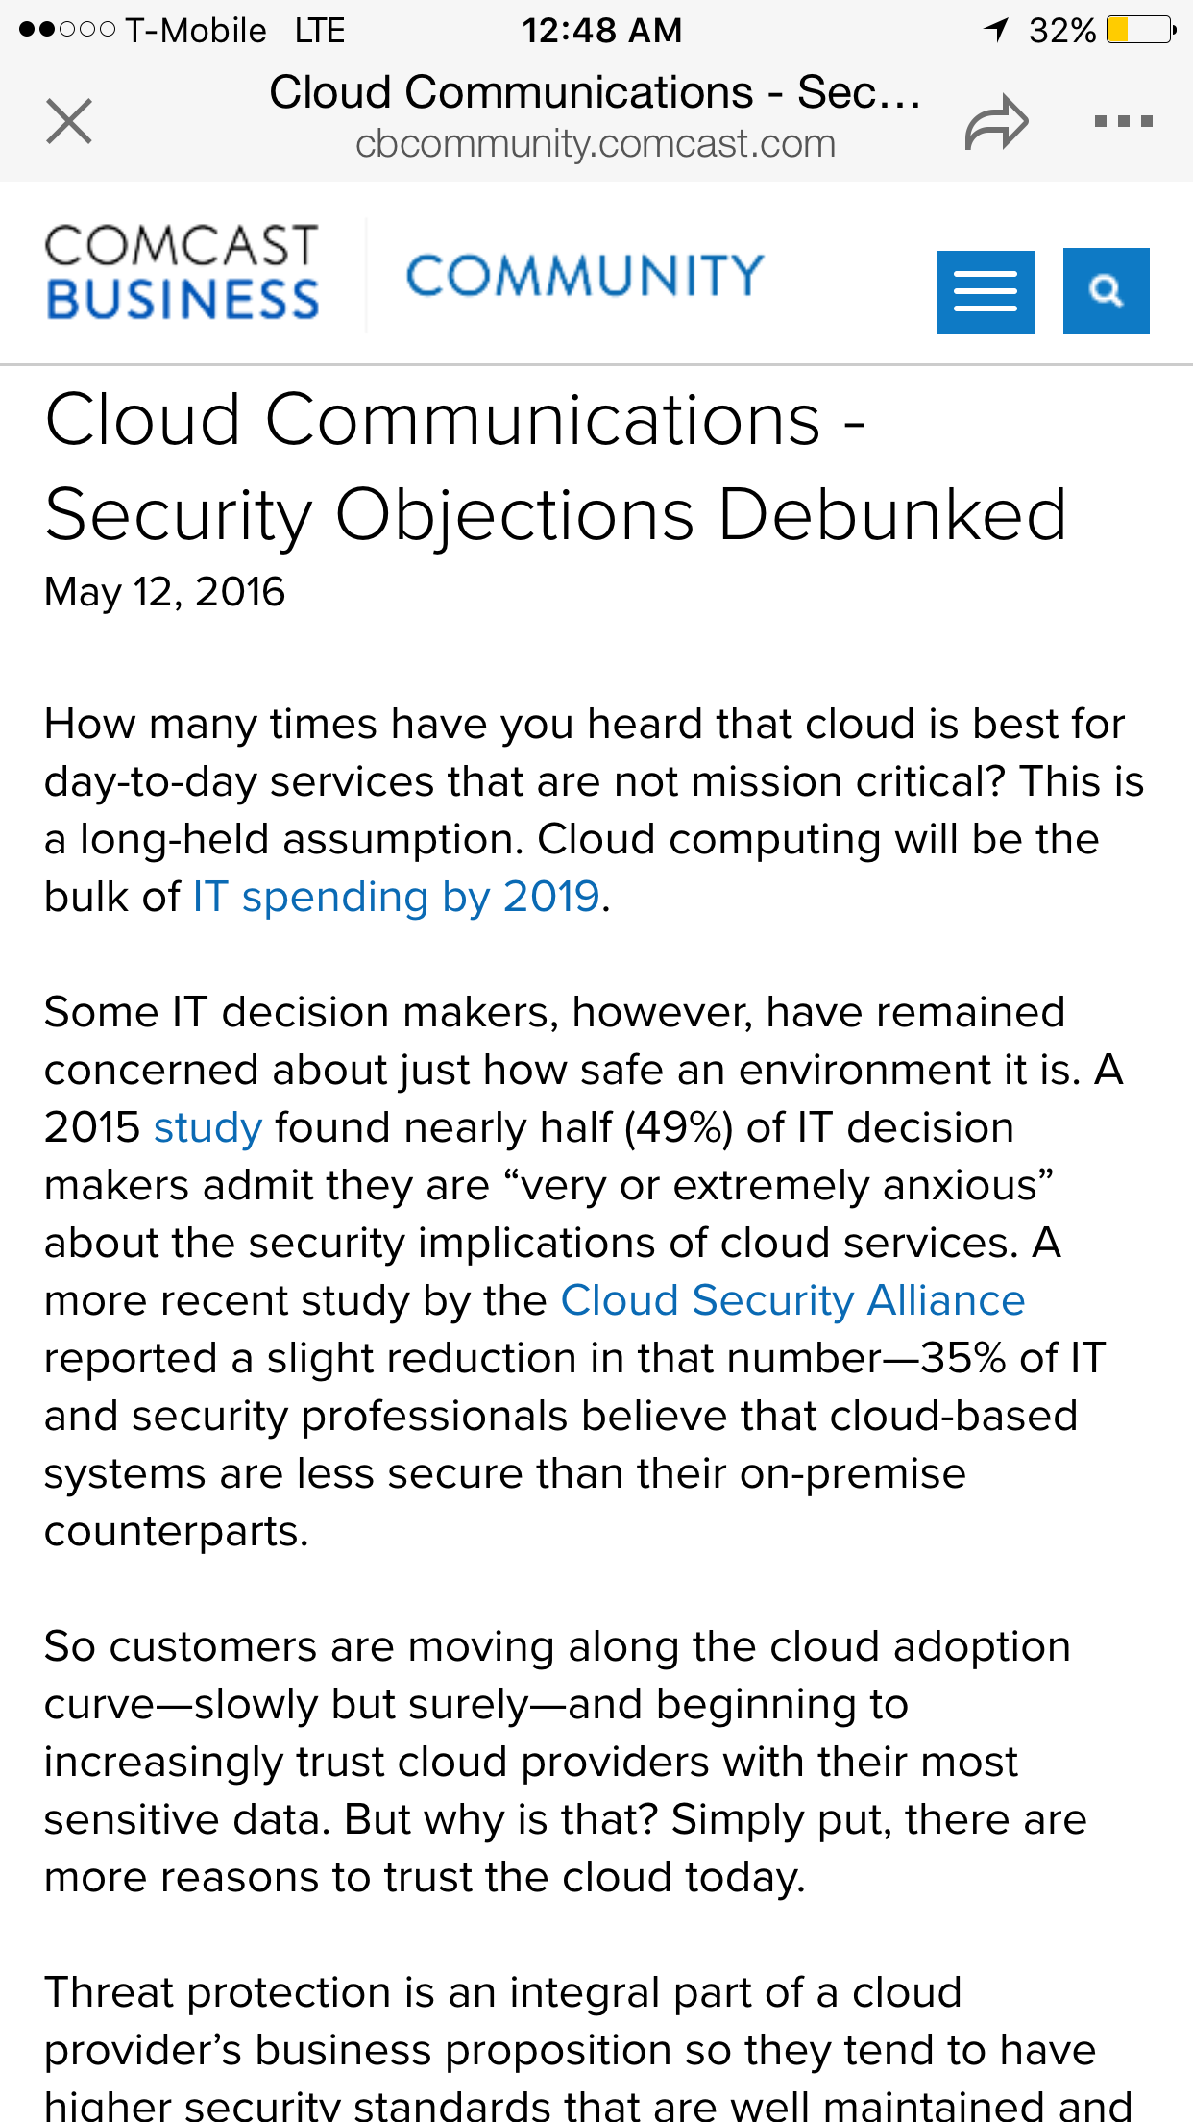
FUTURE ENHANCEMENTS
PROBLEM WITH CLOUD : SECURITY

Slide 27
FUTURE ENHANCEMENTS
To create EC2 Windows and Linux instances with Amazon web services to reduce the infrastructure and to improve performance.
To redesign the Website with more security controls: Validation Controls
To Save the Web application data to Amazon DynamoDB
To Review of Webserver metafiles for information leakage:

Slide 28
CONSLUSION
Security is not a state to achieve but it’s a continuous process.

